Slide 1
Smart Home Automation System
CSE 3216
Microcontroller Based System Design Lab
GROUP MEMBERS:
Anik Hasan Nibir id : 190104054
Zabed Miandad id : 190104057
Md Yousuf Zaman id : 190104059
Sakibul Hasan id : 190104074

Slide 2
Objectives:
1
It automates typical routines as well as giving homeowners the power to manage their home systems remotely.
2
Type commands through phone application for autonomous administration of electrical components.
3
Greater security, detecting burglar using sensors and lock home by using password protection
4
Receive alerts in phone to detect gas leakage, adjust temperature, protects from fire prevent theft
5
One of the main reasons of the smart home is to ease daily life by increasing user comfort

Slide 3
Social Values:
Savings
Smart Thermostats and smart light bulbs save energy, cutting utility costs over time. Some home automation technologies monitor bills.
Safety
Many home automation technologies fall under the umbrella of home security. Automated system uses motion sensors help people from hazard of explosion & offer benefits through remote monitoring to aware from unwanted visitors.
Convenience
Home automation technology performs rote tasks automatically, end users experience great convenience.
Control:
Smart home devices provides better control functions within the home. With home automation technology, you can know what’s happening inside your home at all times.

Slide 4

Project Demonstration:

Slide 5
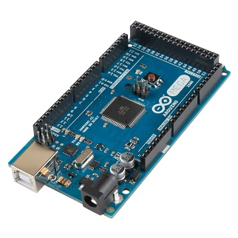
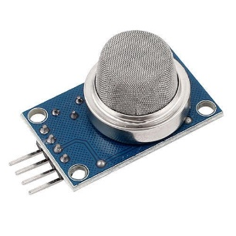
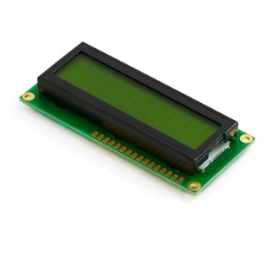
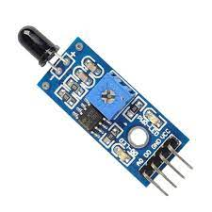
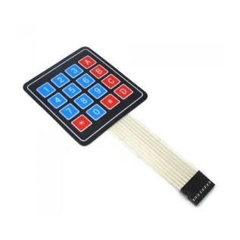
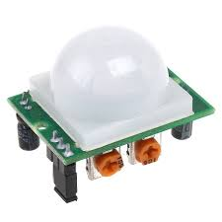
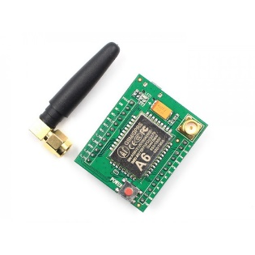
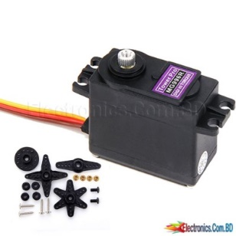
Required Components:
Gas Sensor(MQ-2)
Flame Sensor
PIR Sensor
Motor-PWMSERVO
Arduino Mega 2560
R3
LCD Display()
Keypad(4*4)
GSM module(SIM 900A)

Slide 6
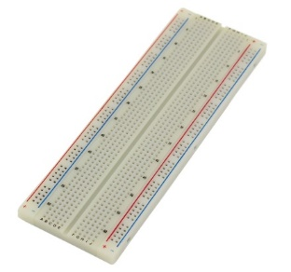

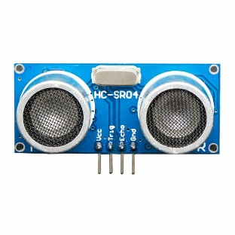
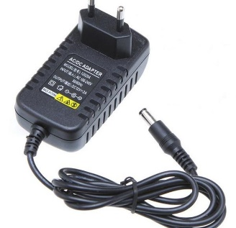
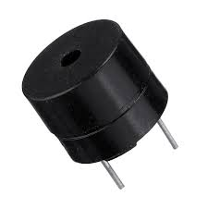
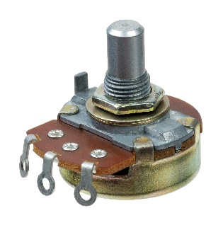
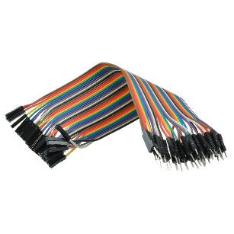
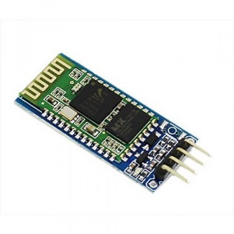
Required Components:
Breadboard
Ultra-sonic Sensor
Buzzer 5v active
Rubber wire &
Wire(m2m,m2f,f2f)
Card board
4.5-12v power adapter
Potentiometer
Bluetooth module

Slide 7
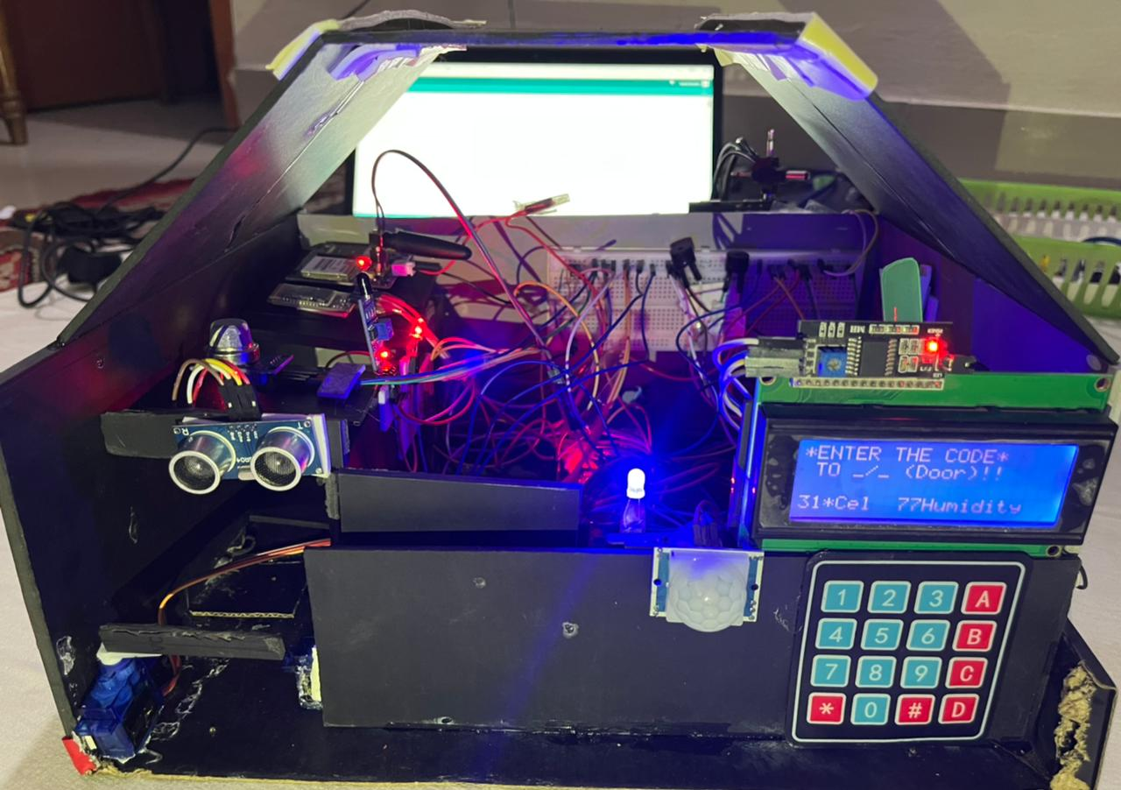
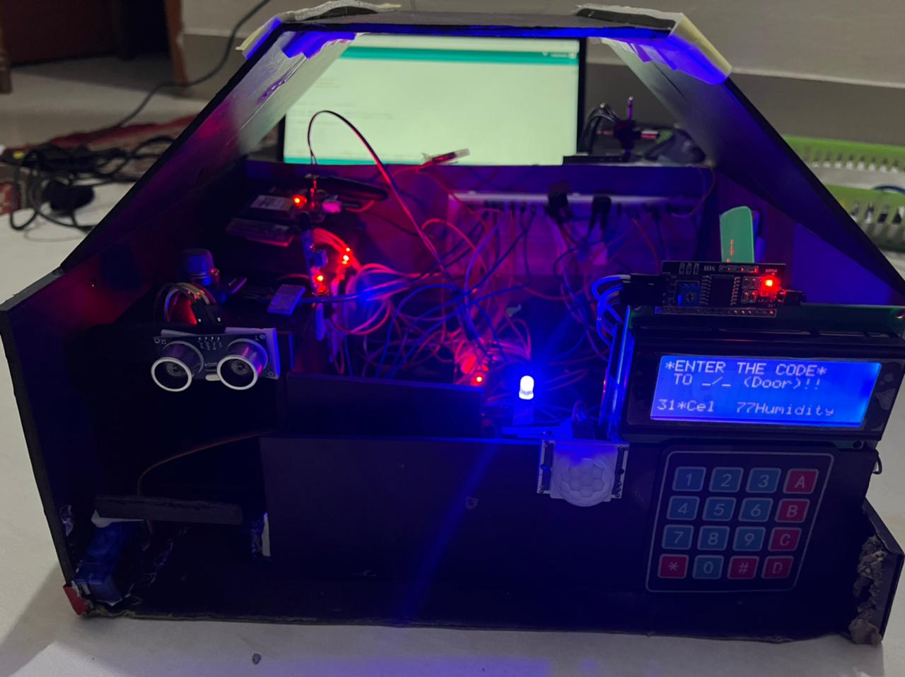
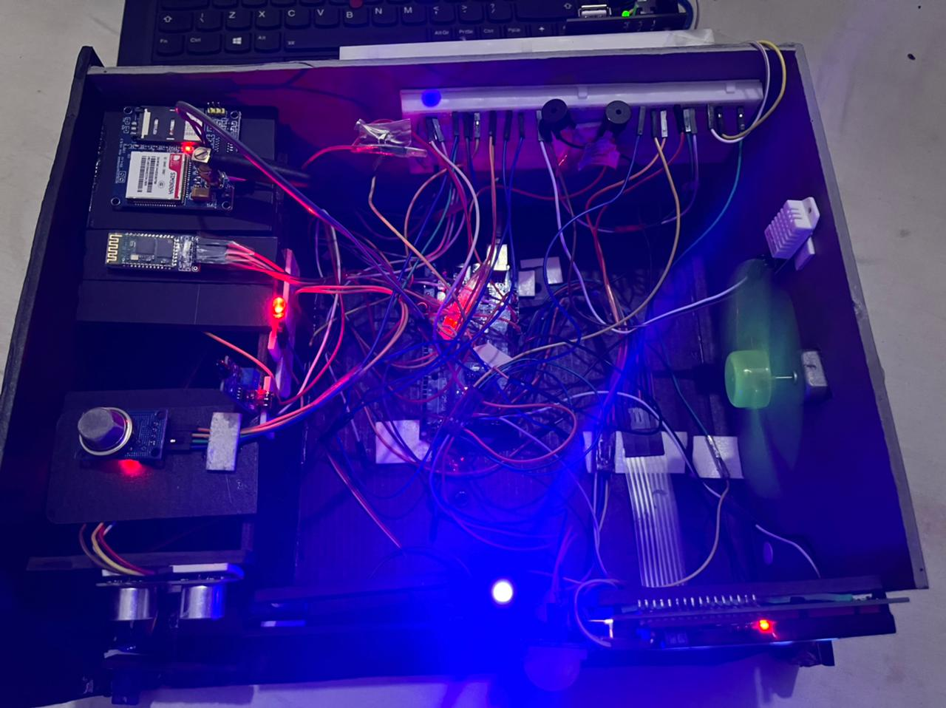
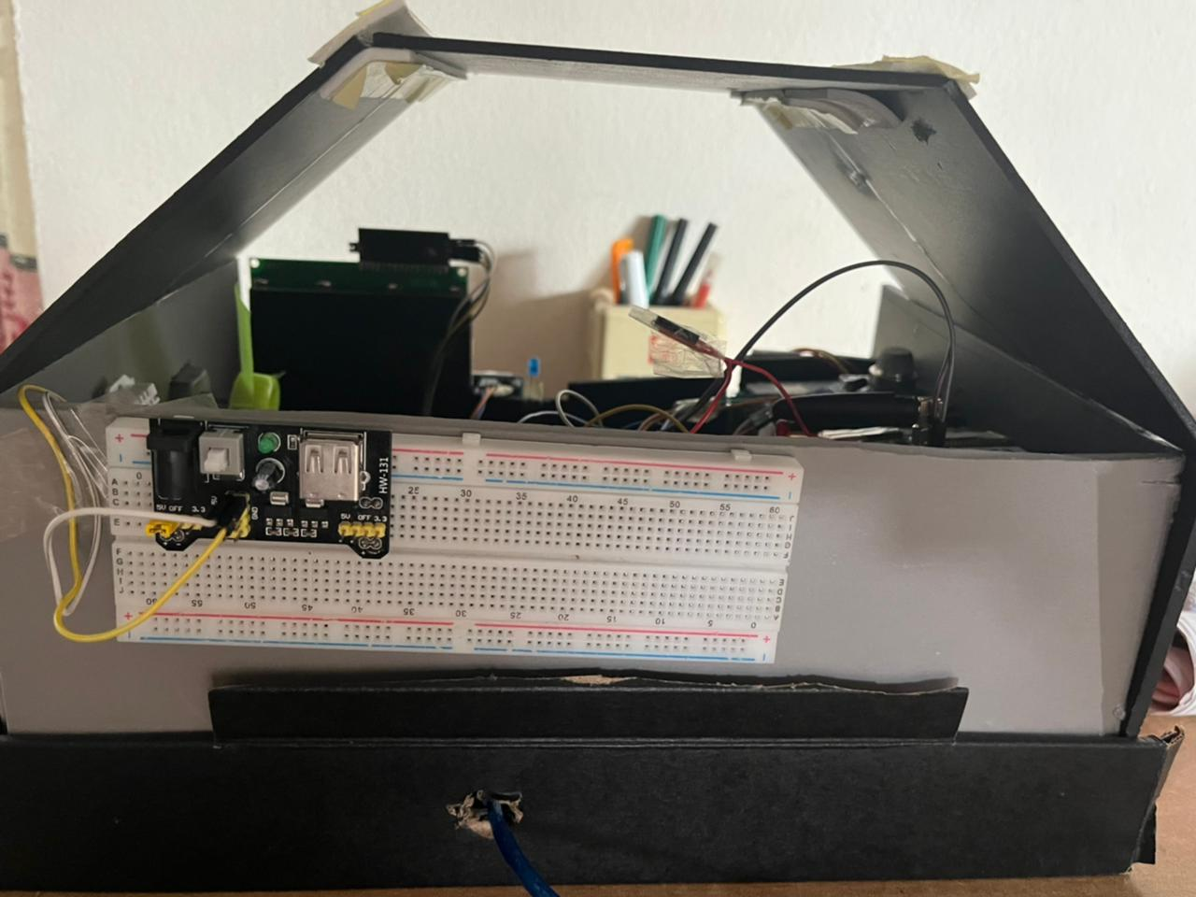
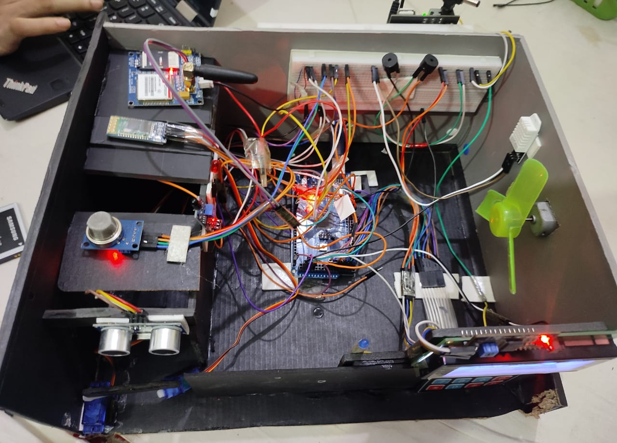
Project Images:

Slide 8
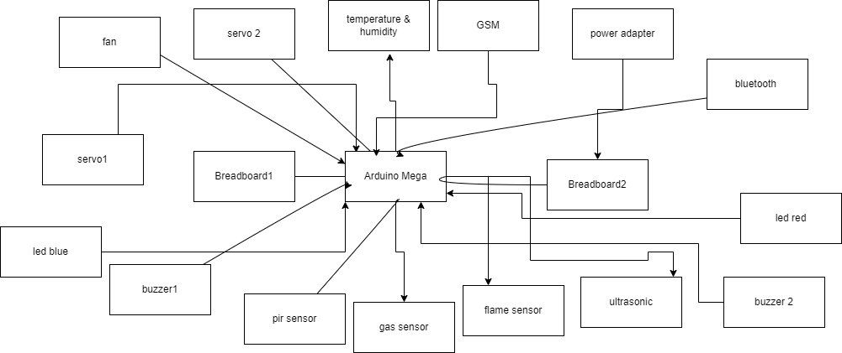
Block Diagram:

Slide 9
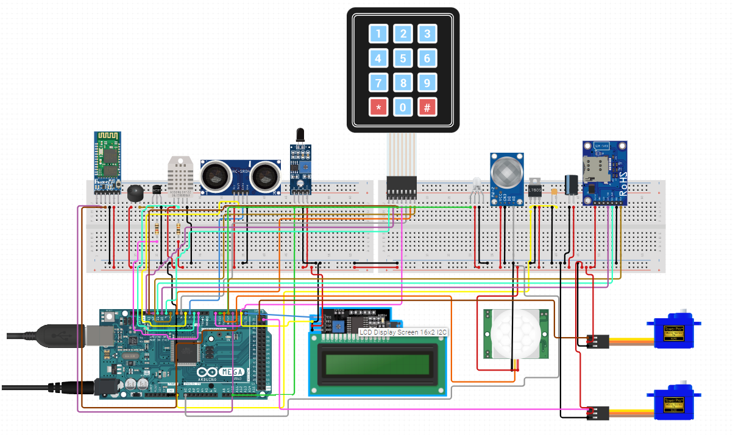
Circuit Diagram:

Slide 10
Working Procedure:
Sends sms and phone call to phone via gsm module when
captured motion and uses commands to control other electrical devices.
Keypad to provide password for unlocking and opening doors
sensors & servomotor used for light ,fan & doors
Sensors to detects gas leakage and smoke, fire breakout, temperature for caution purpose.
PIR sensor
Senses any movement of unwanted intruder & Buzzer initiates
Alarm for the consequence of unwanted event

Slide 11
Estimated Budget:
Equipment's | Quantity | Cost(Tk)
Arduino Mega 2560 R3 | 1 | 1500
LCD Display | 1 | 100
Keypad(6*4) | 1 | 120
GSM Module (SIM 900A) | 1 | 1100
Gas Sensor(MQ-2) | 1 | 120
Flame Sensor | 2 | 120
PIR Sensor | 1 | 100
Ultra-sonic Sensor | 1 | 90
Motor-PWMSERVO | 1 | 140
Buzzer 5v active | 1 | 20
Equipment’s | Quantity | Cost(Tk)
Rubber Wire & Wire(m2m,m2f,f2f) | As required | 200
Potentiometer | 2 | 60
Lipo Nano 850mAh & Charger | 1 | 800
Buzzer 5v active | 1 | 20
Double Connection of/Off Switch | 2 | 30
Led Light (Mix RGB) | As Required | 20
Total |  | 4520

Slide 12
Final Expenditure:
Equipment's | Quantity | Cost(Tk)
Arduino Mega 2560 R3 | 1 | 1500
LCD Display | 1 | 100
Keypad(6*4) | 1 | 120
GSM Module (SIM 900A) | 1 | 1100
Gas Sensor(MQ-2) | 1 | 120
Flame Sensor | 2 | 120
PIR Sensor | 1 | 100
Ultra-sonic Sensor | 1 | 90
Motor-PWMSERVO | 2 | 280
Buzzer 5v active | 1 | 20
Bluetooth Module | 1 | 350
Equipment’s | Quantity | Cost(Tk)
Rubber Wire & Wire(m2m,m2f,f2f) | As required | 200
Dc motor 5v | 2 | 90
4.5-12v power Adapter | 1 | 500
Buzzer 5v active | 1 | 20
Temperature & Humidity Sensor | 2 | 140
Led Light (Mix RGB) | As Required | 20
Total |  | 4870

Slide 13
Contribution:

Slide 14
Challenges of our Project:
❏ keypad keys have issues
❏ Sim kit Sim-kit does not work in some cases.
❏ ultrasonic sensor stops working
❏ The door attached with servo not rotate

Slide 15
Conclusion:
Main purpose of home automation system is to provide ease to people to control different home appliances with the assist of network module based application present in their phones and save electricity, time & money.
People will be encouraged to use our system because of safety measures to prevent accidents
these electrical devices are compatible with one another and can set different triggers between devices to automate regular home processes & gives comfort.

Slide 16
Reference:
❏ www.arduino.cc
❏ www.circuito.io

Slide 17
Any Questions??

Slide 18
Thank You!

